Slide 1

WorldVisitz Mobile Application Agile Delivery Launch
Agile Foundations -
Presentation for the Leadership Team
Part 1: How WorldVisitz Can Benefit From Agile
Part 2: The Optimal Agile Framework for WorldVisitz
Presented by: Long Nguyen
Notes:
Good morning everyone,
Thank you for being here today for my presentation.
My name is Long Nguyen, and I currently work as an Agile consultant. I’m thrilled to have the opportunity to share my knowledge about Agile and discuss how adopting an Agile mindset can benefit your company in the near future.
My presentation will focus on two main parts:
Part 1 (Agile Foundations): How WorldVisitZ can benefit from Agile software development.
Part 2 (Agile Onboarding): The optimal Agile framework for WorldVisitZ.
I believe that my insights into the Agile mindset will open the door to a new way of efficiently managing your projects in the future.
If you have any questions, don't hesitated to let me know.

Slide 2

Part 1: How WorldVisitz Can Benefit From Agile
What is Agile
Agile is an iterative methodology for project management and software development that enables teams to deliver value to customers more quickly.
It not only enhances processes and boosts efficiency for the development team but also delivers significant business value to the organization.
Agile systematically and flexibly tackles common challenges faced by product development teams.
Notes:
Let’s dig into Part 1: How WorldVisitz Can Benefit From Agile
To begin with, we will explore “What is Agile?”

Slide 3
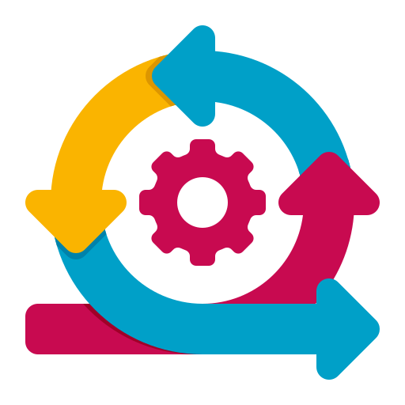
The Agile Manifesto
Individuals and interactions over processes and tools
Working software over comprehensive documentation
Customer collaboration over contract negotiation
Responding to change over following a plan
Notes:
The 4 core values of Agile form the foundation of its approach, driving teams toward successful collaboration and project outcomes:
Individuals and interactions over processes and tools – It strongly emphasizes the need to prioritize our people — the entire team tasked with developing and launching the ‘Worldvisitz App’ in the near future. This approach highlights the importance of skilled individuals and underscores that continuous communication is crucial. Processes and tools should only be valued if they contribute to enhancing the team’s overall performance.
Working software over comprehensive documentation – Traditional project and product management methods placed significant emphasis on extensive documentation, including features, specifications, layouts, requirements, and test cases. However, this often leads to outdated documents that may no longer be relevant or necessary, resulting in wasted time, effort, and resources.
Customer collaboration over contract negotiation – The traditional method followed a very linear approach: Contract Negotiation > Further Changes > Project Completion. This often led to user and customer feedback being overlooked throughout the Software Development Life Cycle (SDLC). In contrast, Agile promotes continuous feedback throughout the product development process. This ensures that any changes or improvements are relevant and aligned with user needs. Additionally, customers, stakeholders, and end users can regularly review and provide input on what is being developed.
Embracing change over sticking to a plan – The short duration of iterations allows priorities to be regularly adjusted and shifted. New features can also be continuously added into subsequent iterations, ensuring the product evolves to meet changing needs.

Slide 4

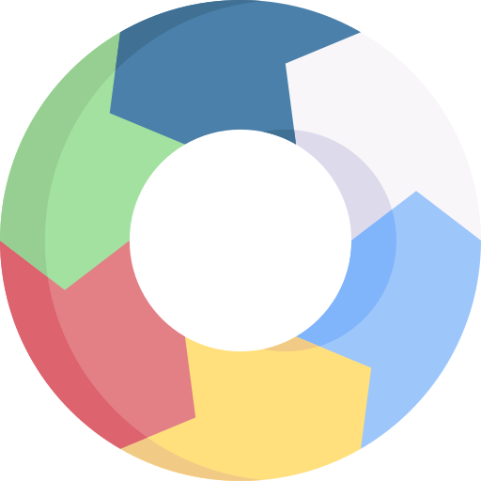

12 PRINCIPLES
Our highest priority is to satisfy the customer through the early and continuous delivery of valuable software.
Ultimately, what truly matters at the end of the lifecycle is a fully functional Worldvisitz Mobile App that integrates seamlessly with the required back end. This is why early feedback and timely corrections are given significant emphasis throughout the development process.
Welcome changing requirements, even late in development. Agile processes harness change for the customer’s competitive advantage.
In the case of WorldVisitz, if end users had been involved in regular interactions with the evolving platform, they would have gained a clearer understanding of the final product. Frequent feedback and testing with real users could have ensured that the product aligned better with their needs and expectations, preventing the confusion and frustration that occurred at launch..
3. Deliver working software frequently, from a couple of weeks to a couple of months, with a preference to the shorter timescale.
Frequent delivery of the product is highly encouraged, as it enhances the agility of the process. In the case of WorldVisitz, if the team had delivered iterations of the platform more frequently, they could have identified risks early and received valuable feedback from stakeholders and end users. This would have allowed them to make necessary adjustments sooner, avoiding the costly and time-consuming changes that were required later in the development cycle.
4. Business people and developers must work together daily throughout the project.
The business and Agile team are aligned, ensuring everyone is on the same page. This also provides developers and solution architects (if applicable) with an “end user’s perspective” of the product or prototype, helping them better understand its purpose and usability.
Notes:
Two Reasons to Follow Agile Practices
Accelerated Time-to-Market
Agile allows iterative development and continuous delivery of working features. This will enable WorldVisitz to launch core functionalities, such as flight booking, in shorter cycles, helping monetize offerings incrementally rather than waiting for the entire 18-month delivery timeline.
Improved Collaboration and Adaptability
Agile emphasizes cross-functional team collaboration, regular feedback loops, and adaptability to changing requirements. This will address WorldVisitz's challenges with knowledge transfer gaps, weak coding standards, and delayed customer feedback, resulting in a more cohesive team and better-quality deliverables.

Slide 5
12 PRINCIPLES
5. Build projects around motivated individuals. Give them the environment and support they need, and trust them to get the job done.
Motivated staff are far more likely to complete the job efficiently and deliver better results.
A positive and supportive work environment fosters productivity and leads to the creation of superior products.
6. The most efficient and effective method of conveying information to and within a development team is face-to-face conversation.
Written communication and memos often contain ambiguities that can lead to confusion.
Face-to-face interactions (when teams are neither remote nor distributed) make product development faster and more accurate.
7. Working software is the primary measure of progress.
The overall improvement of the product should be measured based on the actual working software. Agile emphasizes that software is not truly finished when it is successfully tested and delivered; it is only finished when it has been tested, accepted, and approved by the end user.
8. Agile processes promote sustainable development. The sponsors, developers, and users should be able to maintain a constant pace indefinitely.
Sustainable development requires maintaining a steady and manageable pace, much like running a marathon. Agile emphasizes that development is not a sprint—teams should avoid exhausting their efforts and energy too quickly. At Worldvisitz, our team must remain adaptable and prepared to sustain their productivity over a longer timeframe.

Slide 6
12 PRINCIPLES
9. Continuous attention to technical excellence and good design enhances agility.
Our team should be highly attentive to proper design principles and practices, as this is what brings craftsmanship to life, ensuring high-quality and well-crafted solutions..
10. Simplicity–the art of maximizing the amount of work not done–is essential.
It is crucial to keep the process simple.
Overly complex code and frameworks can lead to confusion and inefficiencies. A simple product or app that meets expectations and effectively serves customer needs is far more valuable than one that attempts to do everything but fails in most, if not all, areas..
11. The best architectures, requirements, and designs emerge from self-organizing teams.
This suggests that the WorldVisitz team should effectively manage their responsibilities and timelines. Self-organizing teams are highly recommended, and it would be beneficial for the team to have a mentor, potentially one of the existing members. Collaboration, teamwork, competency, motivation, continuous growth, and commitment are essential to ensure the success of the project. These principles will help address the issues identified in the WorldVisitz case, ensuring smoother coordination and better outcomes in the development and launch of the platform..
12. At regular intervals, the team reflects on how to become more effective, then tunes and adjusts its behavior accordingly.
Continuous improvement and productivity are strongly encouraged. Agile believes that when a team remains flexible and attentive to changes and potential improvements, it becomes more effective. This leads to a natural increase in productivity. In the context of WorldVisitz, this mindset would help the team identify areas for enhancement throughout the project, ensuring better outcomes and a more efficient development process.

Slide 7
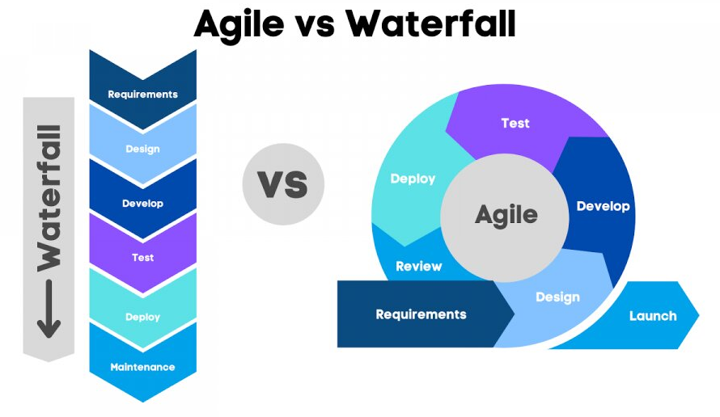
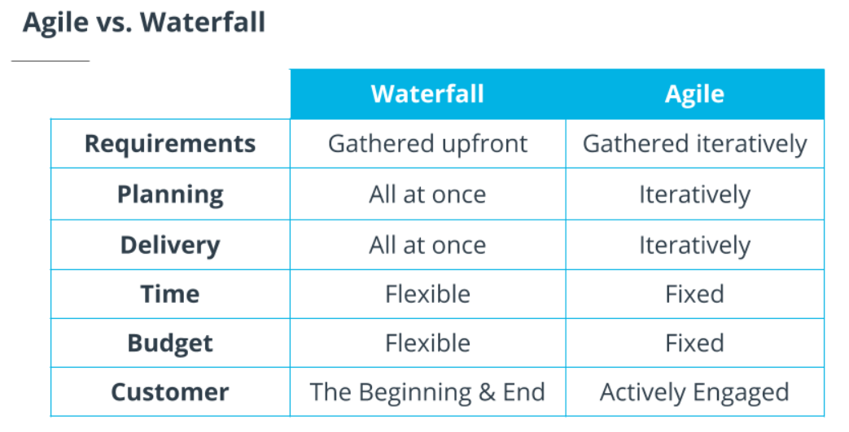
Key differences between Agile and Waterfall
Notes:
When discussing project management methodologies, it’s essential to understand the key differences between Agile and Waterfall.
While both are widely used, they represent two distinct approaches to handling projects.
Waterfall follows a linear, sequential process where each phase is completed before moving on to the next, making it predictable but less adaptable to changes.
In other hand, Agile is iterative and flexible, focusing on delivering smaller, functional parts of the project in cycles or "sprints," which allows for frequent feedback and adjustments throughout the process. Let’s explore how these two methodologies differ in their approach and how they impact the way teams work and deliver results.
In waterfall, all customer requirements are gathered in detail at the beginning before development begins. In agile, because the scope is flexible to allow for change, we gather it iteratively in order to incorporate customer feedback in waterfall planning is done up front before development begins. In agile planning is done iteratively to avoid wasting time planning features in detailing requirements far out into the future. In waterfall, the development team builds and delivers the product based on the detailed requirements and the customer receives the product when it is fully finished. In agile, we interact with customers along the way and deliver features or value to the customer as it is developed. In waterfall, we can extend the time for as long as we need to ensure that all requirements are complete. In agile, we keep a fixed timeline and manage scope by focusing on customer value to meet deadlines. In waterfall, the budget is increased if needed, to ensure that all requirements are complete. In agile, the budget is fixed and we control the budget by managing scope and delivering the highest priority value to customers. In waterfall, the customer gives the requirements at the beginning and is delivered the product at the end upon completion. In the agile approach, that customer is actively engaged in planning and the product is delivered to them as work is completed, so that they can give feedback about the product, which informs the product plan and priorities.

Slide 8

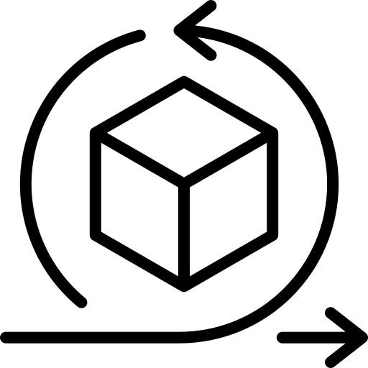


The benefits of Business Agility to WorldVisitz
The benefits of Business Agility to WorldVisitZ can be significant, helping the company thrive in a dynamic and competitive environment.
Faster Response to Market Changes: With business agility, WorldVisitZ can quickly adapt to changes in the market, customer preferences, and emerging trends. This allows the company to stay ahead of competitors and seize new opportunities as they arise.
Improved Customer Satisfaction: Agility enables WorldVisitZ to be more responsive to customer feedback, allowing the company to make continuous improvements to its services and offerings. This results in higher customer satisfaction and loyalty.
Increased Innovation: With an agile mindset, WorldVisitZ can experiment with new ideas, test them quickly, and adjust based on results. This culture of innovation can lead to new solutions and improvements, helping the company stay innovative in a competitive market.
Notes:
As WorldVisitz operates in a dynamic industry where customer expectations evolve rapidly, being agile is no longer optional—it's a strategic necessity.
Business Agility empowers organizations like WorldVisitz to:

Slide 9
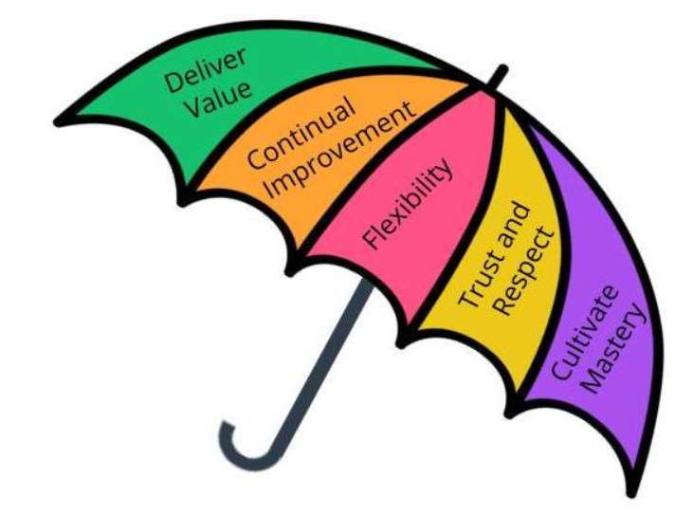
What is Agile Umbrella
The Agile Umbrella
The Agile Umbrella has some key characteristics:
Deliver Value: An absolutely key driver behind anything Agile is to deliver value.
Continual Improvement: Agile promotes incremental improvement to minimize resistance from all who are involved.
Flexibility: Flexibility is one of the foundations of any Agile Framework.
Trust and Respect: Agile Frameworks promote trust and respect because such trust and respect motivate Agile teams.
Cultivate Mastery: This built-in structure for Agile team members to hone their skills further motivates the Agile team.

Slide 10
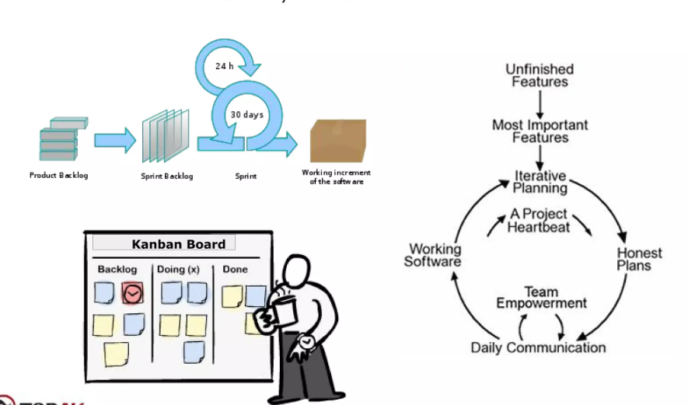
Scrum, Kanban and XP
Aspect | Scrum | Kanban | XP
Approach | Iterative, time-boxed sprints | Continuous flow of work | Emphasizes engineering excellence
Iteration Length | Fixed-length sprints (usually 2-4 weeks) | No fixed iteration length | Continuous delivery in small releases
Focus | Deliverables and team collaboration | Flow and task management | Technical practices and customer feedback
Roles | Defined roles (Scrum Master, Product Owner, Development Team) | Defined roles (Scrum Master, Product Owner, Development Team) | Defined roles (Customer, Tester, Coach, Programmers)
Workflow Management | Time-boxed work in sprints | Visualized flow, WIP limits | Emphasis on code quality and practices
When to Use | When there’s a need for structure and regular feedback | For continuous work without specific iterations | When high-quality code and customer involvement is critical
Notes:
In the world of Agile methodologies, teams often encounter multiple frameworks that can drive efficiency, improve collaboration, and deliver value faster. Among these, Scrum, Kanban, and Extreme Programming (XP) are three widely adopted practices, each with unique principles and advantages.
To select the best approach for a project, it’s crucial to understand the differences between these frameworks and how they align with specific team goals, workflows, and challenges.
Here are the difference:

Slide 11
Part 2: The Optimal Agile Framework for WorldVisitz
Notes:
Shift to Part 2: ….

Slide 12
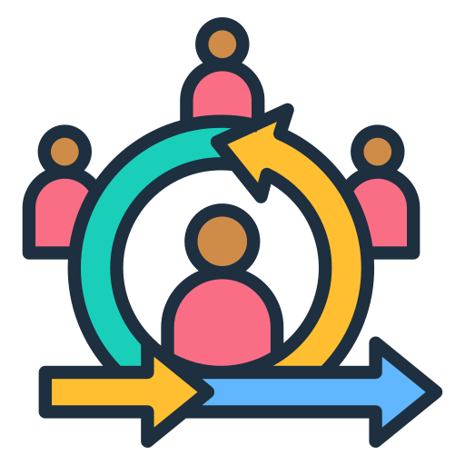
Overview Scrum
SCRUM
A lightweight framework designed to tackle complex, adaptive problems.
It places strong emphasis on simplicity and follows the scientific approach of 'empiricism.' The focus is on people rather than tools and documentation.
Scrum teams consist of the following roles: Product Owner, Scrum Master, and Development Team Member.
Notes:
I’d like to introduce about Scrum Framework:

Slide 13
Scrum Events
SCRUM EVENTS
Sprint - All work in Scrum is done in a series of short projects called Sprints. This enables rapid feedback loops.
Sprint Planning - The Sprint starts with a planning session in which the Developers plan the work they intend to do in the Sprint. This plan creates a shared understanding and alignment among the team.
Daily Scrum - The Developers meet daily to inspect their progress toward the Sprint Goal, discuss any challenges they’ve run into and tweak their plan for the next day as needed.
Sprint Review- At the end of the Sprint, the Scrum Team meets with stakeholders to show what they have accomplished and get feedback.
Sprint Retrospective - Finally, the Scrum Team gets together to discuss how the Sprint went and if there are things they could do differently and improve in the next Sprint.
Notes:
Scrum events are the heartbeat of the Scrum framework, designed to provide structure and consistency for the team’s collaboration. Each event serves a unique purpose, ensuring alignment, transparency, and continuous improvement throughout the development process. These time-boxed ceremonies create opportunities for the team to plan, reflect, and adapt their approach to deliver maximum value. Let’s explore the key Scrum events: Sprint Planning, the Daily Scrum, the Sprint Review, and the Sprint Retrospective, to see how they contribute to a seamless and effective workflow.

Slide 14
Scrum Artifacts
Notes:
These artifacts act as tangible outputs or tools that enable the team to organize, track, and share their work effectively. They provide a clear window into the current state of the project, what has been completed, and what still lies ahead. By leveraging these artifacts, Scrum teams ensure they remain focused on delivering value to the customer while continuously improving their processes. Now, let’s dive into the three key Scrum artifacts: the Product Backlog, the Sprint Backlog, and the Increment.
Product Backlog:
This serves as the single source of truth for all requirements.
For SocialKare.gov, the Product Backlog might include items such as:
User registration functionality
Eligibility verification workflow
Integration with government databases
User interface enhancements for accessibility
The Product Owner continuously refines and prioritizes the backlog, ensuring the team works on high-value features first, such as basic enrollment forms.
Sprint Backlog:
For each Sprint, the team selects a subset of items from the Product Backlog to complete.
For example, in Sprint 1, the focus might be on building and testing the user registration page.
The Sprint Backlog includes:
Tasks for coding the registration form
Implementing backend data validation
Writing test cases for user input
The Development Team regularly updates progress during Daily Standups, keeping everyone aligned and transparent.
Increment:
By the end of each Sprint, the team delivers a working, shippable product increment.
In this case, the increment might be a fully functional registration module that stakeholders can interact with.
This allows the team to gather early feedback from government officials and make improvements before moving on to more complex features like eligibility verification.

Slide 15
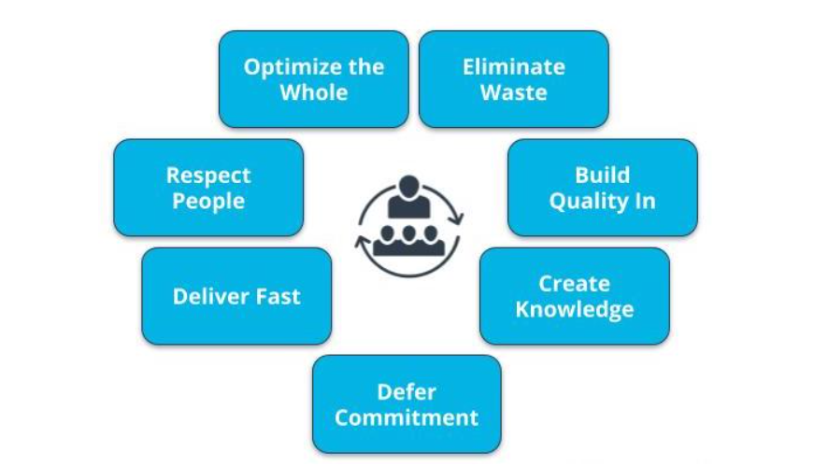
Overview Kanban
Kanban
Kanban is a flexible and visual workflow management method designed to improve efficiency and deliver value continuously. Originating from lean manufacturing principles, Kanban focuses on visualizing work, limiting work in progress (WIP), and optimizing the flow of tasks through a system. Unlike rigid frameworks, Kanban is adaptive and can be seamlessly integrated into existing processes, making it suitable for teams across various industries.
Lean Principles:
Notes:
I’d like to introduce about Kanban and Lean Principles is foundation of Kanban Framework

Slide 16
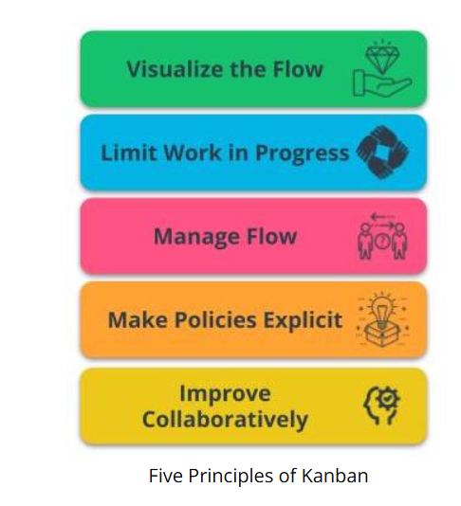
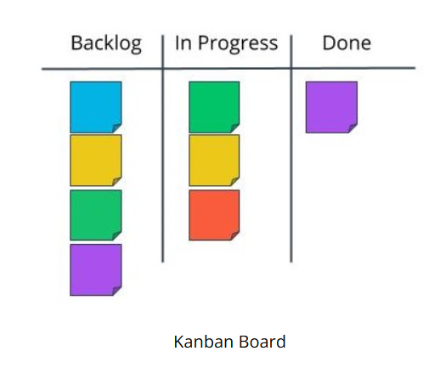
Kanban Principles and Kanban Board
Notes:
I’d like to introduce about Kanban and Lean Principles is foundation of Kanban Framework:
When exploring Kanban, it’s important to highlight its foundational principles and tools that make it so effective for managing workflows and enhancing productivity. At the heart of Kanban are its five principles, which provide a structured yet flexible approach to optimizing processes and delivering value. These principles focus on visualizing work, managing flow, and fostering continuous improvement, creating an environment where teams can thrive.
Visualize the Flow - The Team visualizes the workflow, which helps in organizing, tracking, and optimizing the work.
Limit Work in Progress- Limiting WIP helps to smooth the flow of work, reduce lead times, improve quality and delivery more frequently.
Manage Flow - By Monitoring and measuring the flow of work, issues are identified as soon as possible, which improves delivery predictability.
Make Policies Explicit - Establishing policies provides the Agile Team with explicit understanding of the processes for discussions around issues.
Improve Collaboratively - The Agile Team must own the team’s work related processes and work collaboratively to improve the processes being utilized.
A key tool in implementing Kanban is the Kanban Board—a powerful visual aid that brings clarity and transparency to the workflow. The board allows teams to track tasks, identify bottlenecks, and make informed decisions in real-time. Together, the principles and the Kanban board empower teams to work more efficiently while adapting to changing demands. Let’s dive into these five principles and see how the Kanban board supports them in practice.

Slide 17
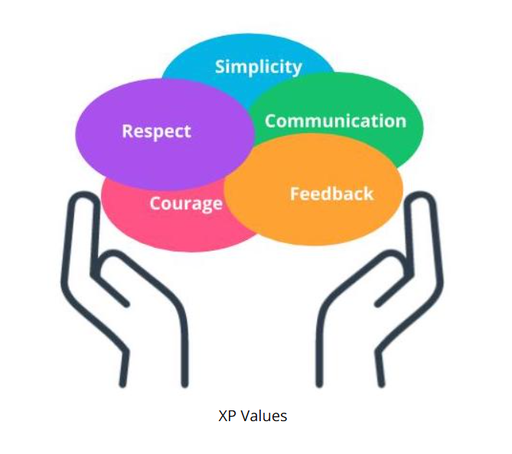
Overview XP
XP Framework
Extreme Programming, also known as XP, is a powerful Agile Framework with its roots in software development. XP has a strong focus on technical excellence and best practices in software development.
XP values:
Notes:
Extreme Programming (XP) is a software development framework designed to improve software quality and responsiveness to changing customer requirements. It emphasizes frequent releases, close collaboration, and continuous feedback, making it especially effective in dynamic environments. XP encourages teams to embrace change and prioritize simplicity, delivering value incrementally while maintaining high code quality.
At the heart of XP are its five core values: Communication, Simplicity, Feedback, Courage, and Respect. These values guide how teams interact, solve problems, and deliver solutions. By fostering open communication and emphasizing feedback loops, XP creates a culture of trust and adaptability. Let’s explore how these values shape the XP framework and help teams thrive in complex development projects.

Slide 18
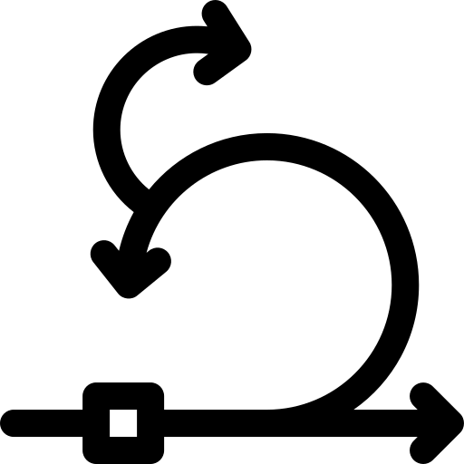
The recommended framework for WorldVisitz is
SCRUM
Notes:
Adopting Scrum could provide an effective solution to many of the challenges faced during the development of WorldVisitz.
By emphasizing incremental delivery, regular feedback loops, and collaborative teamwork, Scrum addresses several pain points highlighted in the post-mortem analysis.
Here's how:

Slide 19
The pain points that challenges WorldVisitz is
Customer feedback is received late
The team lacks close collaboration, both in terms of physical presence and shared spirit.
Requirements and product planning are handled entirely at the beginning of the project.
Notes:
Every organization faces unique challenges that hinder its growth, efficiency, and ability to deliver value.
For WorldVisitz, these challenges might include delayed feedback, lack of collaboration, and requirements are defined at the beginning of project and could not change.
All of which can impact the timely delivery of critical features.
By identifying and understanding these pain points, we can propose solutions that directly address the root causes. Adopting a framework like Scrum or Agile practices enables organizations to navigate complexity, streamline processes, and ensure continuous delivery of value to end-users.
Now, let’s explore the key challenges WorldVisitz is currently facing and how we can effectively overcome them.

Slide 20
How Scrum can solves these problems
Scrum ceremonies are designed to emphasize the importance of early feedback loops.
A Scrum Board enables the team to collaboratively plan their work and maintain focus on achieving the Sprint goal.
In Scrum change is the norm, and requests are
re-prioritized at Sprint boundaries
Notes:
Here's how can Scrum solves these problem:
Frequent Iterations: Scrum's iterative approach ensures that the product evolves incrementally. Delivering smaller, functional pieces of the website throughout the project could have helped identify and resolve coding errors, scaling issues, and incomplete requirements early, reducing the risk of a disastrous launch.
Engagement with Stakeholders: Scrum encourages continuous collaboration with stakeholders, ensuring that their input is integrated throughout the project lifecycle. This would have addressed the lack of business user, internal team engagement and the unclear requirements that plagued SocialKare.gov.
Adaptability to Change: Scrum welcomes changing requirements, even late in development. This flexibility would have helped the project team respond to evolving agency needs without the delays caused by a rigid change control process.

